Slide 1
Testing
PowerPoint presentation
Unit 304: Electrical Installations: inspection, testing and commissioning

Slide 2
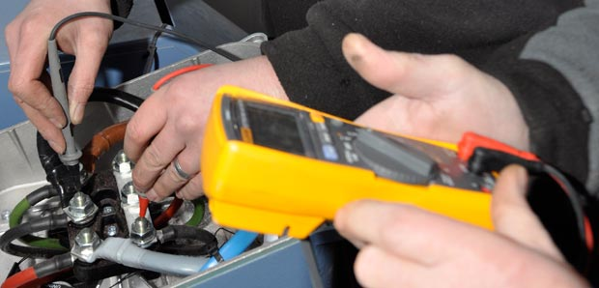
Testing
Why carry out testing
Testing is carried out to confirm the observations made during the inspection process and form part of the initial verification and the periodic inspection processes.

Slide 3
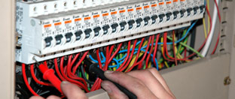
Testing
Order of testing
Many tests rely on the results of certain other tests being correct.
Any test which fails to produce an acceptable result must be repeated after remedial action has been taken.
Any other tests, whose results may have been influenced by the fault concerned, must also be repeated.

Slide 4
Testing
Order of testing
Before the supply is connected:
Continuity of protective conductors, including main and supplementary bonding (612.2.1 - page 199)
Continuity of ring final circuit conductors (612.2.2 - page 199)
Insulation resistance (612.3 - page 199)
Polarity (612.6 - page 200)
Earth electrode resistance (612.7 - page 200).

Slide 5
Testing
Order of testing
With supply connected:
Protection by automatic disconnection of the supply (612.8 - page 201)
Earth fault loop impedance (612.9 - page 202)
Prospective fault current measurement (612.11 - page 202)
Check of phase rotation (612.12 - page 201)
Functional testing, including RCDs and switchgear (612.13 - page 202)
Verification of voltage drop (612.14 - page 202).

Slide 6
Testing
Preparing for testing
When preparing to carry out testing, whether as part of initial verification or a periodic inspection, it is important to follow a set procedure. This should include the following:
Risk assess safe system of work.
Precautions to be taken when carrying out tests.
Safe isolation.
Instrumentation fit for purpose.
Communication with clients.
Range and limitations.
Implications to others.

Slide 7
Testing
These can be summarised as follows:
Make sure that all safety precautions are observed.
Have a clear understanding of the installation, how it is designed and how it has been installed.
Make sure that the instruments to be used for the tests are to the necessary standards (BS4743 and BS5458) and have been recently calibrated to ensure their accuracy.
Check that the test leads to be used are in good order, with no cracked or broken insulation or connectors, and are fused where necessary to comply with the Health and Safety Executive Guidance Note GS38.
Be aware of the dangers associated with the use of high voltages for insulation testing. For example, cables or capacitors connected in a circuit that has been insulation tested may have become charged to a high potential, and may hold it for a significant time.

Slide 8
Test instruments
Test | Instrument | Scale
Continuity | Low resistance ohmmeter | 0.2Ω to 2Ω with a resolution of 0.01Ω (digital). No‑load voltage of 4V to 24V (a.c. or d.c.). Short circuit current not less than 200mA.
Insulation resistance | Insulation resistance tester | Most meters have three ranges: 20MΩ, 200MΩ and 2000MΩ. Should generate required test voltage (e.g. 500V for a 230V circuit).
Polarity (dead) | Usually achieved during the continuity test. | This is a ‘Go’ or ‘NO GO’ test so no reading taken.
Earth electrode resistance | Earth electrode resistance | Typical ranges 20Ω, 200Ω and 2000Ω
Earth fault loop impedance | Earth fault loop impedance tester | Typical range 20Ω at 6A for 20ms
Prospective fault current | Prospective fault current tester usually incorporated into earth fault loop impedance tester | Typical range1000A, 10kA and 50kA.
Phase rotation | Phase rotation tester | Light or disc indication of direction of rotation.
Functional test (RCD) | RCD tester | 10mA, 20mA, 30mA, 100mA, 300mA and 500mA. 0.5 x I_{Δn}, 1 x I_{Δn} and 5 x I_{Δn}.
Voltage drop | Approved voltage tester | Typical range 12V - 690V

Slide 9
Any questions?

